Slide 1

TeleBehavioral Health 2025 Training Series
Behavioral Health Institute (BHI)
Harborview Medical Center
Website: https://bhinstitute.uw.edu
Email: bhinstitute@uw.edu
Northwest Regional
Telehealth Resource Center (NRTRC)
Website: https://nrtrc.org
Email: info@nrtrc.org
September 19, 2025

Slide 2
Behavioral Health Institute (BHI)
Training, Workforce and Policy Innovation Center
The Harborview Behavioral Health Institute (BHI) is a program of Harborview Medical Center that is dedicated to advancing innovation, research and clinical practice to improve community mental health and addiction treatment. The BHI also serves as a resource for the advancement of behavioral health outcomes and policy, and supporting sustainable system change.
The BHI brings the expertise of Harborview Medical Center/UW Medicine and other university partners together to address the challenges facing Washington’s behavioral health system, through innovation and improving access to effective behavioral health care. BHI pillars include:
Clinical Services
Research and Program Evaluation
Training, Policy and Workforce Development
Expanded Digital and Telehealth Services and Training

Slide 3

Northwest Regional Telehealth Resource Center (NRTRC)
Telehealth Technical Assistance Center
The NRTRC delivers telehealth technical assistance and shares expertise through individual consults, trainings, webinars, conference presentations and the web.
Their mission is to advance telehealth programs' development, implementation and integration in rural and medically underserved communities.
The NRTRC aims to assist healthcare providers, organizations and networks in implementing cost-effective telehealth programs to increase access and equity in rural and medically underserved areas and populations.
These sessions were made possible in part by grant number U1UTH42531-03 from the Office for the Advancement of Telehealth, Health Resources and Services Administration, DHHS.

Slide 4
Speaker Disclosures
None of the series speakers have any relevant conflicts of interest to disclose.
Planner disclosures
The following series planners and team have no relevant conflicts of interest to disclose:
Brad Felker MD Nicki Perisho RN
Cara Towle MSN RN Jaleen Johnson
Topher Jerome
Mylinh Thao

Slide 5
DISCLAIMER
Please be aware that policy changes may take place after the original date of this presentation.
Any information provided in today’s talk is not to be regarded as legal advice. Today’s talk is purely for informational purposes.
Please consult with legal counsel, billing & coding experts, and compliance professionals, as well as current legislative and regulatory sources, for accurate and up-to-date information.

Slide 6


We gratefully acknowledge the support from

Slide 7

TeleBehavioral Health 2025
Low Barrier OUD Treatment at Scale: The Development and Growth of a Pilot Telebuprenorphine Hotline
Lauren K. Whiteside, MD, MS
Associate Professor and section head of population health
Olivia hood, mph, ches
Assistant director of population health
Chris buresh, MD, MPH
Associate professor of emergency medicine
september 19, 2025

Slide 8
Roadmap
Opioid Crisis
Telehealth Regulations
Medications for OUD
UW DEM Team and Program Philosophy
Telebupe In Action

Slide 9
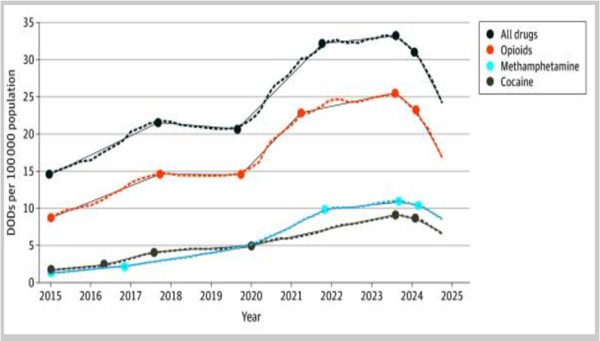



Slide 10
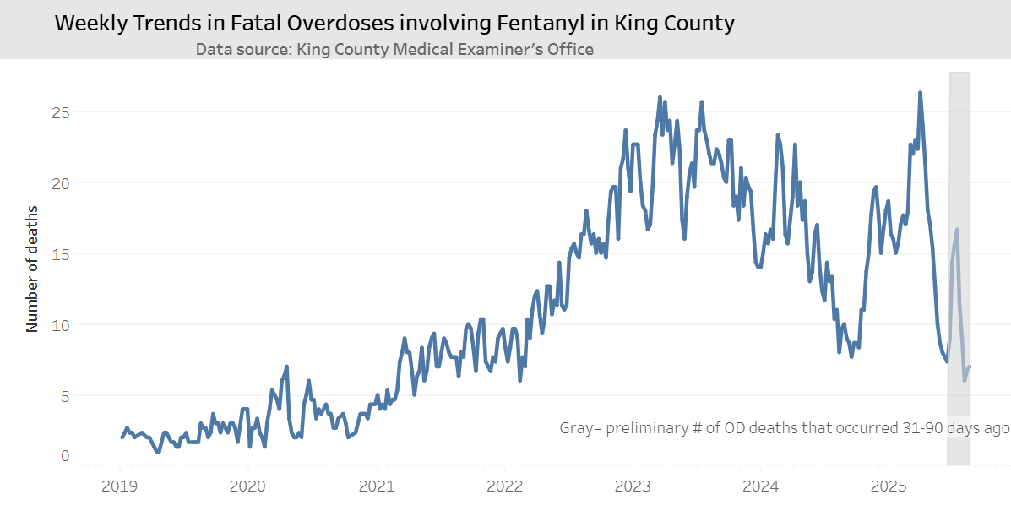
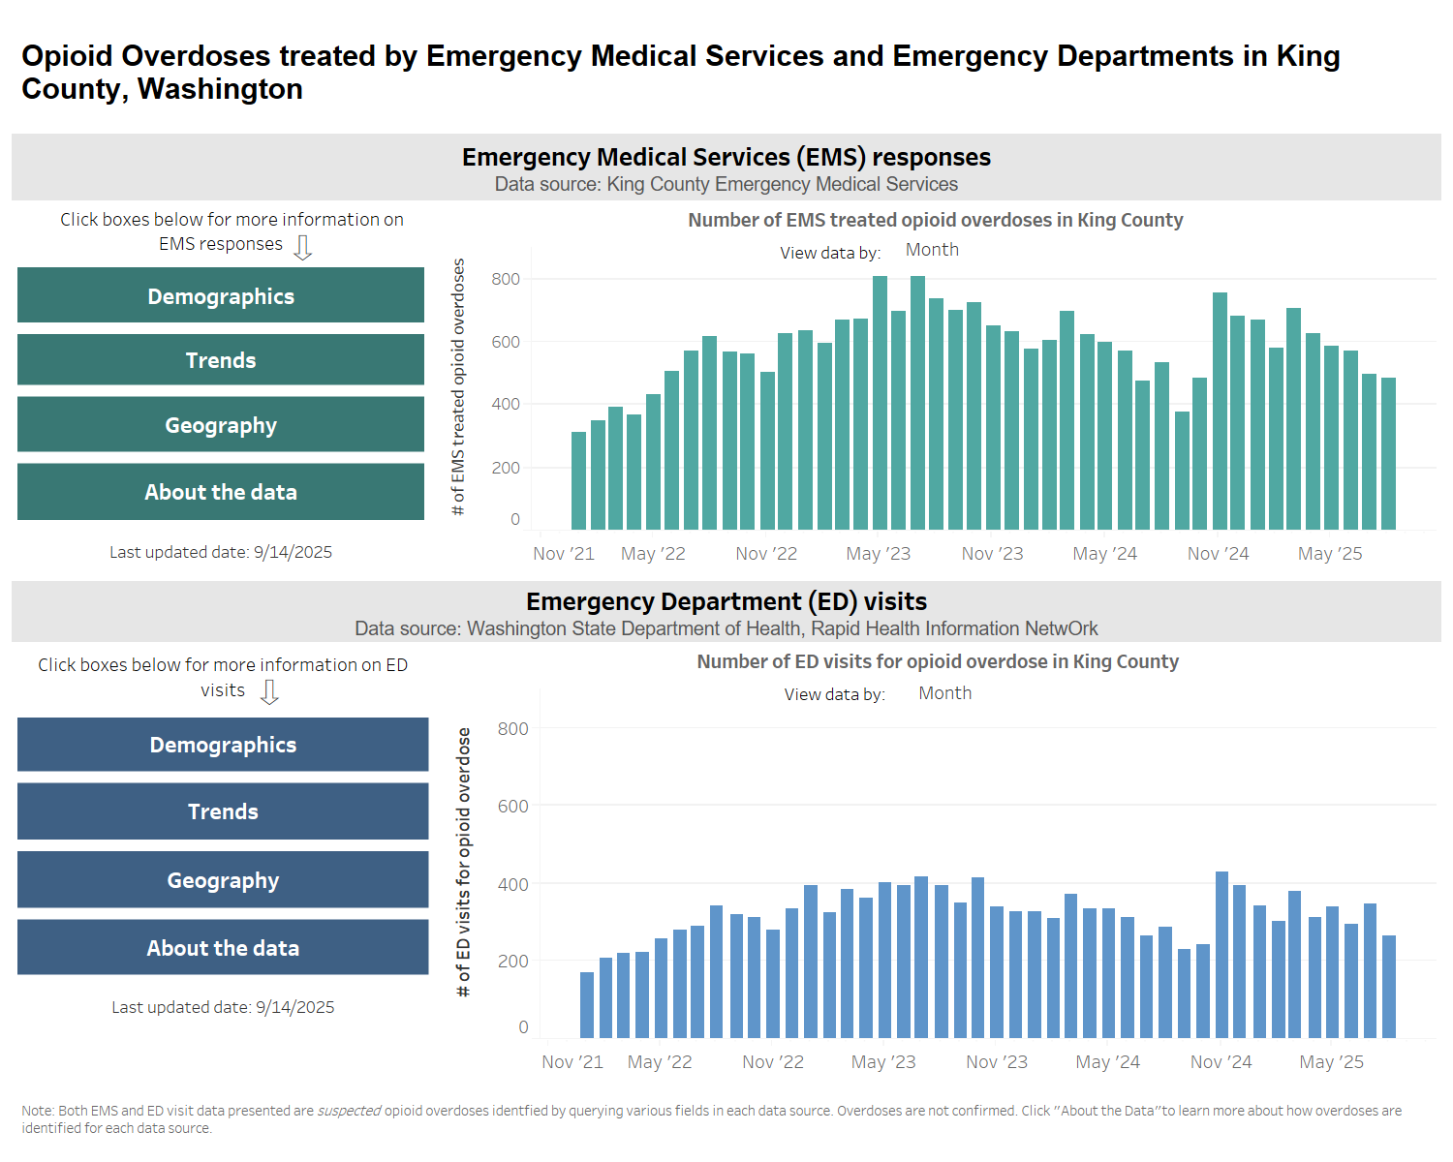
King County Opioid Dashboard as of 9/18/2025
In 2024, there were 1,044 opioid overdose deaths in King County.
There have been 655 so far in 2025.

Slide 11
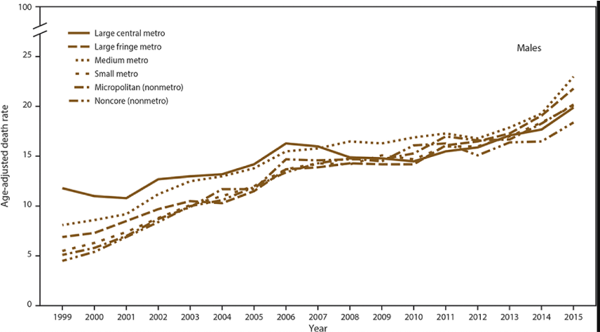
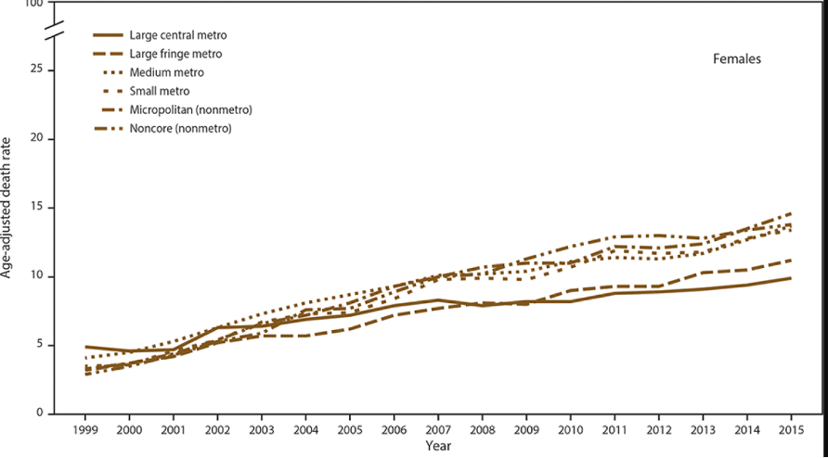

IT IS A RURAL PROBLEM

Slide 12

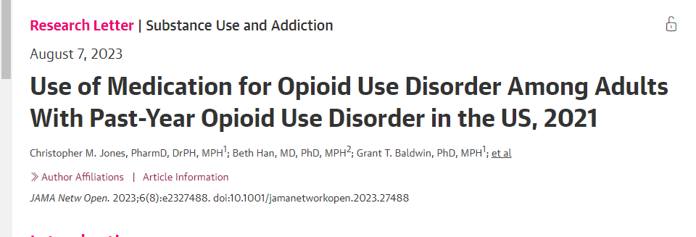

In 2021:
2.5 million adults in the US had OUD in the past year
Only 1 in 5 received medications to treat OUD

Slide 13
Help prevent overdoses and keeps people safer
Reduce emergency room visits and hospital stays
Help people use fewer illegal drugs
Lower the risk of death from opioid use
Support people in staying in treatment and getting better
Improve daily life and overall well-being
For patients with opioid use disorder, buprenorphine can:

Slide 14
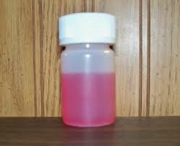
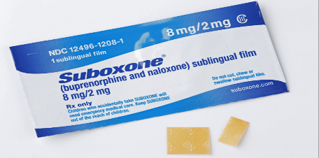
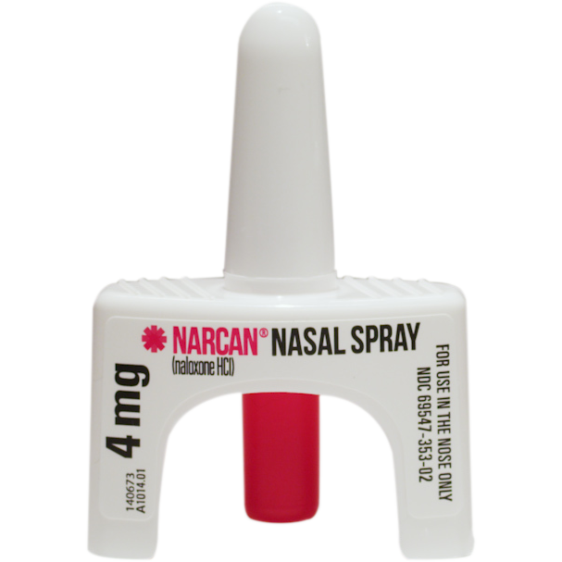
MOUD: Buprenorphine
Think of your brain like a car.
Fentanyl is like pressing the gas pedal all the way down—too fast, too dangerous, and can crash.
Buprenorphine is like cruise control—it keeps things steady and safer.
Partial agonist
Suboxone has naloxone in it
Prevents withdrawal symptoms
Prevents cravings
Prevents overdose
FDA approved for 16 and over

Slide 15
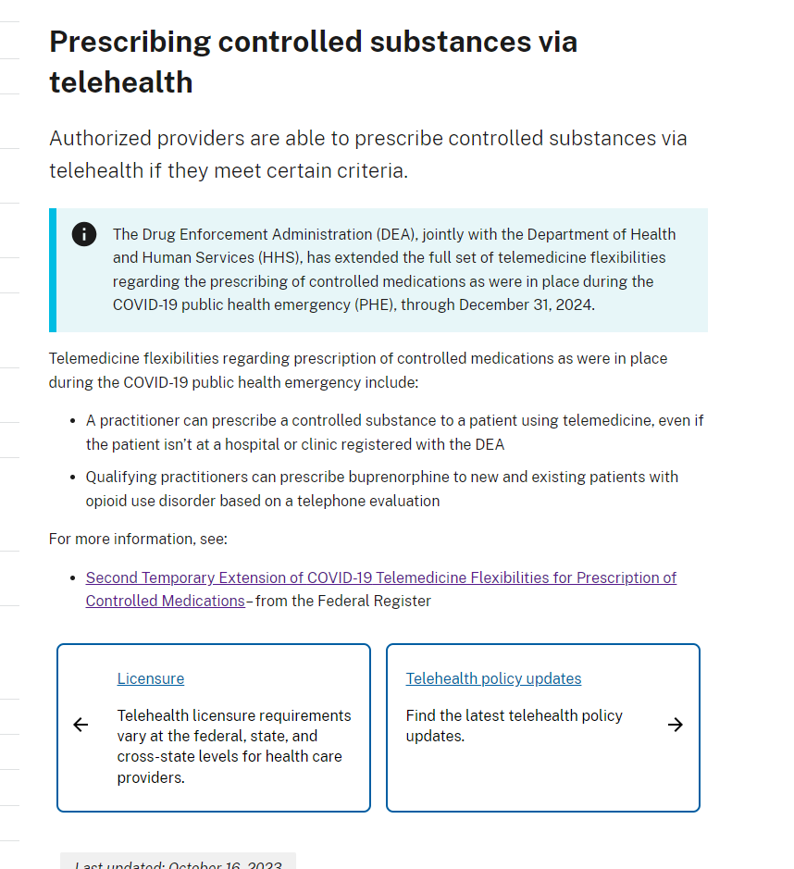
Federal Telehealth regulations for prescribing controlled substance
Must have audio-video capabilities
Patient must be in the state the prescriber has a license to practice in.

Slide 16
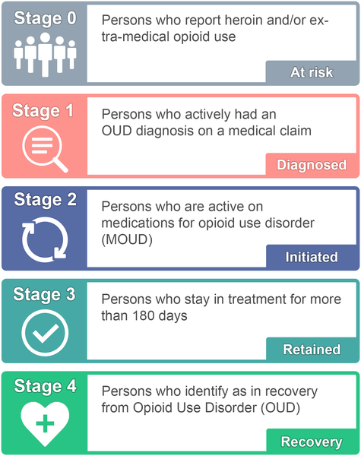
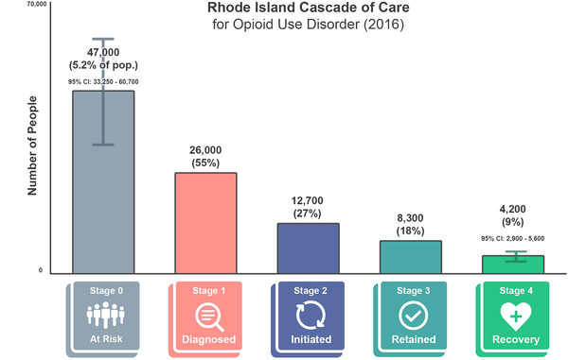

Yedinak JL, Goedel WC, Paull K, Lebeau R, Krieger MS, et al. (2019) Defining a recovery-oriented cascade of care for opioid use disorder: A community-driven, statewide cross-sectional assessment. PLOS Medicine 16(11): e1002963. https://doi.org/10.1371/journal.pmed.1002963
Notes:
While most affected individuals eventually receive an opioid use disorder diagnosis by a health care professional during their lifetime, only 20-40% are estimated to receive care in any given year. The largest gap in the treatment cascade is from diagnosis to initiation of treatment. I would pose that this gap can be reduced by initiating treatment in on-demand settings like telehealth

Slide 17
Telebuprenorphine Pilot Overview 01/02/2024-06/30/2025
Staffed by 11 Emergency Medicine Physicians (Including 2 Residents)
Staffed by 1 Linkage to Care Coordinator & 1 Program Manager
9A-9P availability for patients
PHSKC Funding

Slide 18
Program Buprenorphine Prescribing Philosophy
High-dose start:
(24 mg-32 mg on day 1)
Use other medications to make people comfortable

Slide 19

Buprenorphine Diversion
Does occur sometimes
Vast majority of diverted medicine is used to treat withdrawal
Only 4% of people who use diverted buprenorphine use it as their drug of choice

Slide 20
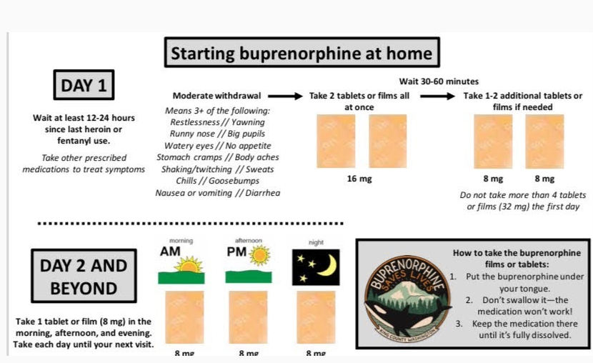
General Buprenorphine self-start instructions

Slide 21








Program Philosophy: Patient-Centered
Patient
Accessible
Empathic
Responsive
Efficient
Respectful
Notes:
Accessible
Empathic
Responsive – Our goal is the phone is

Slide 22
Patient Experience
Patients need to be in the state of Washington and 13+ yo
Treatment for OUD (not chronic pain or to transition from methadone to bup)
We do NOT bill for our visit, however they still pay for their medication
LTCC will assist linking patient to longitudinal care
Up to 3 prescriptions in 3 months

Slide 23
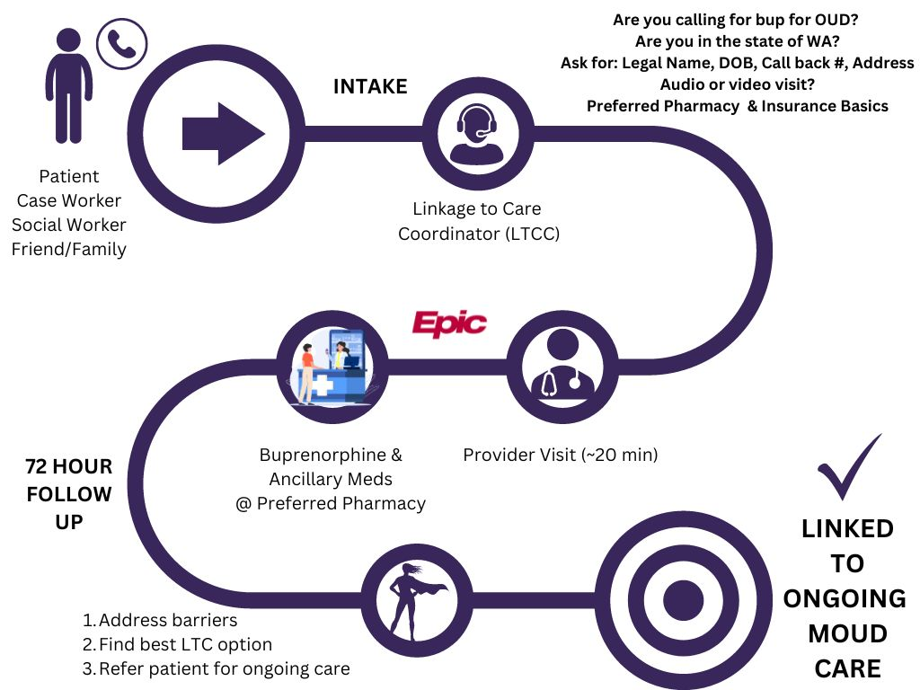
Pilot Telehealth Hotline Workflow
- Average wait time to see a provider: 13 minutes

Slide 24
Linkage to Care Coordinator
Assists with patient triage & reducing barriers to accessing medication 7 days a week
Reaches out to patient within 72 hours after their first visit to facilitate linkage to care
Will complete at least three outreach attempts to all patients via phone call, text, and/or email (average 5-10 attempts)
We link patients to verified referral partners based on patient need and preference

Slide 25
Linkage to Care Impact
Our Syndemic Linkage to Care Approach:
Additional linkage services we can provide:
PCP referral (with MOUD)
Behavioral Health referral
HIV care referral
HCV care referral
PrEP rx referral Support group resources
Family support resources
Food bank/clothing resources
Barriers & needs we address in intake:
Recent Overdose
Location
Telehealth preference
No Insurance
GoodRx coupons OR local walk-in clinic
Help patients sign up for insurance
UW Financial Assistance Line
Transportation Issues
Find public transportation routes
Language Barrier
24/7 translation services

Slide 26

Our Pilot Program
Pilot Time Frame
January 2, 2024 – June 30, 2025
Hotline Activity
CALLS - 5824
TEXTS - 9120

Slide 27
Over 1000 patients served in the pilot.
January 2024 – June 2025 | Stats
Unique Patients | 1043
Total Telehealth Visits | 1447
Buprenorphine Prescriptions | 1262
Referred for ongoing care | 62.2%
Already established in care (bridge rx) | 30.3%
Lost to follow-up | 7.5%

Slide 28
Lessons Learned
People's lives are complex
Boundaries
Wait 72 hours for follow up phone calls
Handoffs are important
QI and Multidisciplinary Discussion

Slide 29

Questions?

Slide 30
Thank you!
Contact Us:
Lauren Whiteside – laurenkw@uw.edu
Chris Buresh – cb79@uw.edu
Olivia Hood – ohood@uw.edu
Section of Population Health, Department of Emergency Medicine

Slide 31
Looking for Health Equity & Ethics Training?
Cultural Humility In Behavioral Health Care
Free two-hour module
On-demand & self-paced
Meets Health Equity training requirements in WA State
Empowering Recovery: Ethics & Collaborative Decision-Making in Behavioral Health
Free two-hour module
On-demand & self-paced
Meets Law & Ethics training requirements in WA State
Learn more at: https://bhinstitute.uw.edu/learn-online

Slide 32


TeleMental Health Guides for Infancy to Young Adults
Guides (8)
Infancy and Toddlers
Pre-schoolers
Elementary School Children
Middle School Youth
High School Teens
Young Adults
Neuropsychological Testing
Suicidality
uwcolab.org/tmh-guides

Slide 33


Additional Free Resources for Washington State
Behavioral Health Providers
*No cost
Post-TBI Nutrition
– Natasha Mehta
TODAY
12-1.30pm
EDUCATIONAL SERIES:
UW Traumatic Brain Injury – Behavioral Health ECHO → → →
UW Psychiatry & Addictions Case Conference ECHO
UW TelePain series
PROVIDER CONSULTATION LINES
UW Pain & Opioid Provider Consultation Hotline
Psychiatry Consultation Line
Partnership Access Line (pediatric psychiatry)
Perinatal Psychiatry Consultation Line

